Slide 1
When Social Networks meet Semantic Web —@2006-2012, AMiner.org
Jie Tang
Knowledge Engineering Group Department of Computer Science and Technology Tsinghua University
Notes:
1

Slide 2






Social Networks
>1000 million users
The 3rd largest “Country” in the world
More visitors than Google
>721 million users
2012, users, 300% yearly increase
400 million
2009, 2 billion tweets per quarter
2010, 4 billion tweets per quarter
2011, tweets per quarter
25 billion
More than 6 billion images
Pinterest, with a traffic higher than Twitter and Google

Slide 3
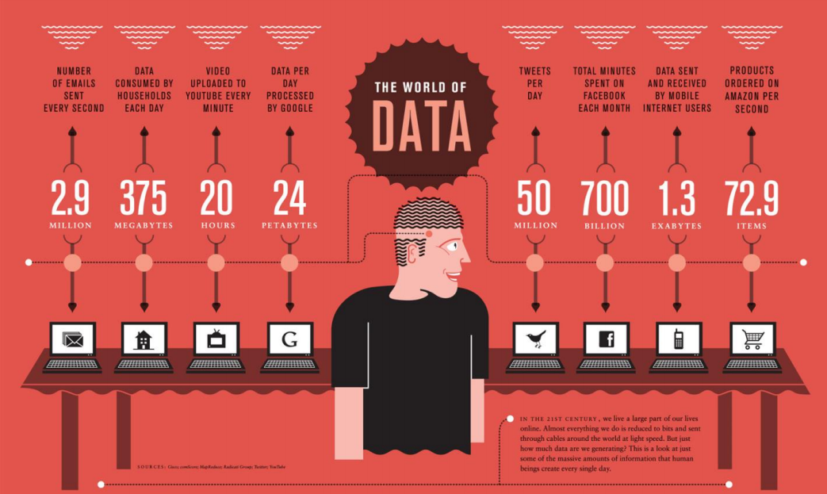
每秒钟，人们发送290万封电子邮件
Notes:
以下四页作为动画引出大数据时代的到来

Slide 4
每分钟，人们通过YouTube 上传20小时的视频

Slide 5
每个月，人们在Facebook 上 共浏览7000亿分钟

Slide 6
每秒钟，亚马逊处理72.9笔订单

Slide 7
淘宝双十一购物节
11.11购物狂欢节，天猫和淘宝吸引了2.13亿独立用户访问，相当于有四成网民参与了狂欢节。仅第一分钟就吸引了1000万独立用户加入抢购，相当于一个中等西欧国家的全部人口。一个小时内，支付宝完成付款笔数598万笔，当天订单数达到了1.058亿笔

Slide 8
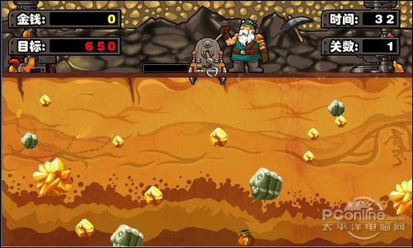
A Trillion Dollar Opportunity
Social networks already become a bridge to connect our daily physical life and the virtual web space
On2Off ^{[1]}
Goal: 1,000,000,000,000 dollar…
[1] Online to Offline is trillion dollar business
http://techcrunch.com/2010/08/07/why-online2offline-commerce-is-a-trillion-dollar-opportunity/
Notes:
With the growth of local commerce on the Web, the links between online and physical commerce are becoming stronger.
The key to O2O is that it finds consumers online and brings them into real-world stores. . It is a combination of payment model and foot traffic generator for merchants (as well as a “discovery” mechanism for consumers) that creates offline purchases. It is inherently measurable, since every transaction (or reservation, for things like OpenTable) happens online. This is distinctively different from the directory model (think: Yelp, CitySearch, etc) in that the addition of payment helps quantify performance and close the loop—more on that later.
What do Groupon, OpenTable,Restaurant.com, and SpaFinder all have in common? They grease the wheels of online-to-offline commerce.

Slide 9
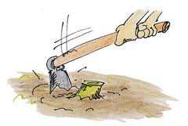
However……
Terribly, we are still working with “hoe”…

Slide 10
Big Data Mining needs Knowledge
发现和充分利用大数据的价值需要新型数据挖掘与分析方法，能够从非结构化数据的庞大宝藏中获得知识和洞察力
组织互联网知识
Google, Bing, Sogou…
大数据 + 知识

Slide 11
从数据的网络到知识的网络 —Data Web->Semantic Web
Well, this is not a new concept…

Slide 12
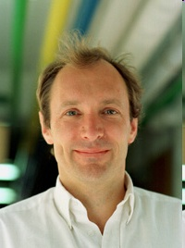
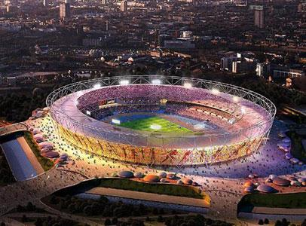
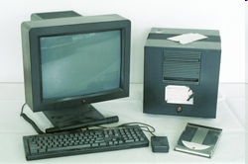
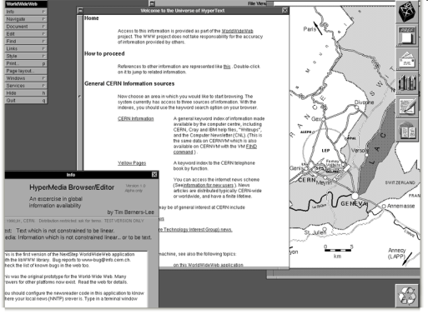
世界上第一台Web服务器
Tim Berners-Lee
http://info.cern.ch
“This is for every one”
体系结构
Internet
hypertext (HTML)
Web Browser
HTTP
Engineer changed the World
Notes:
About http://info.cern.ch
CERN, the European Organization for Nuclear Research, is where it all began in March 1989. A physicist, Tim Berners-Lee, wrote a proposal for information management showing how information could be transferred easily over the Internet by using hypertext, the now familiar point-and-click system of navigating through information. The following year, Robert Cailliau, a systems engineer, joined in and soon became its number one advocate.
The idea was to connect hypertext with the Internet and personal computers, thereby having a single information network to help CERN physicists share all the computer-stored information at the laboratory. Hypertext would enable users to browse easily between texts on web pages using links.
Resources:
[1] http://info.cern.ch/default.html

Slide 13
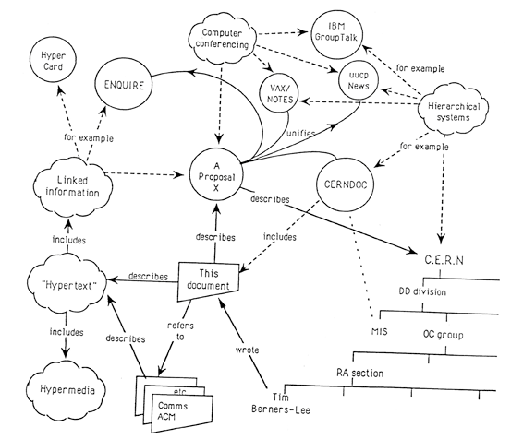
Tim Berners-Lee’s Proposal in 1989
Linked information system
Linked Data was there
Notes:
Where is this module used?
Who wrote this code? Where does he works?
What documents exist about the concept?
Which laboratories are included in that project?
Which systems depend on this device?
What documents refer to this one?

Slide 14
Build semantic links between data
用语义Web技术：
1. 在Web上公布结构化数据
2. 建立从一个数据资源到另一个数据资源的链接
RDF
RDF
RDF
RDF
RDF
RDF
RDF
RDF
RDF
RDF
RDF link
RDF links
RDF links
RDF links
A
B
C
D
E

Slide 15
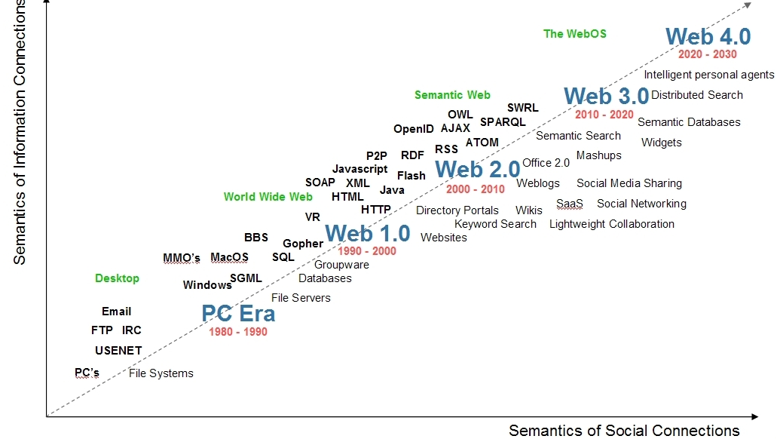
Timeline

Slide 16
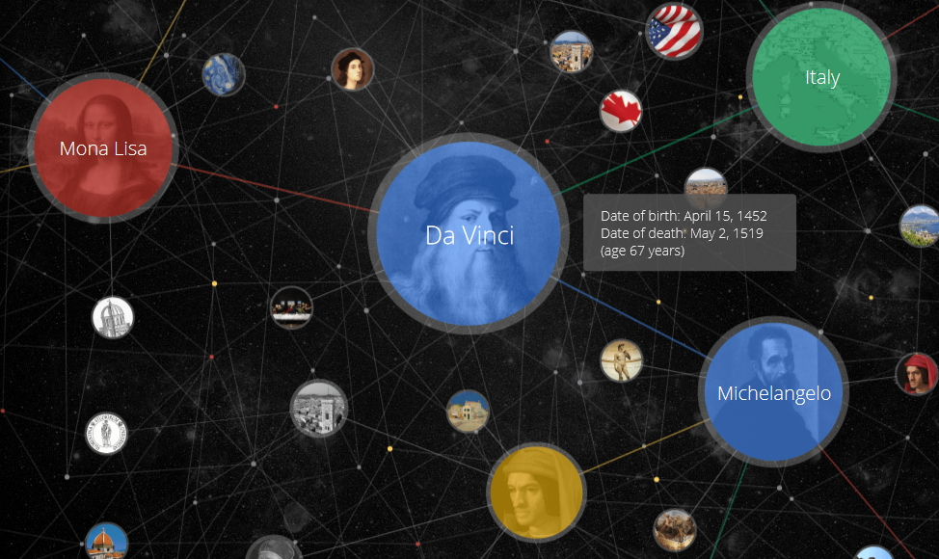
A “mistake”…
“Bible”: RDF, DAML+OIL, OWL

Slide 17
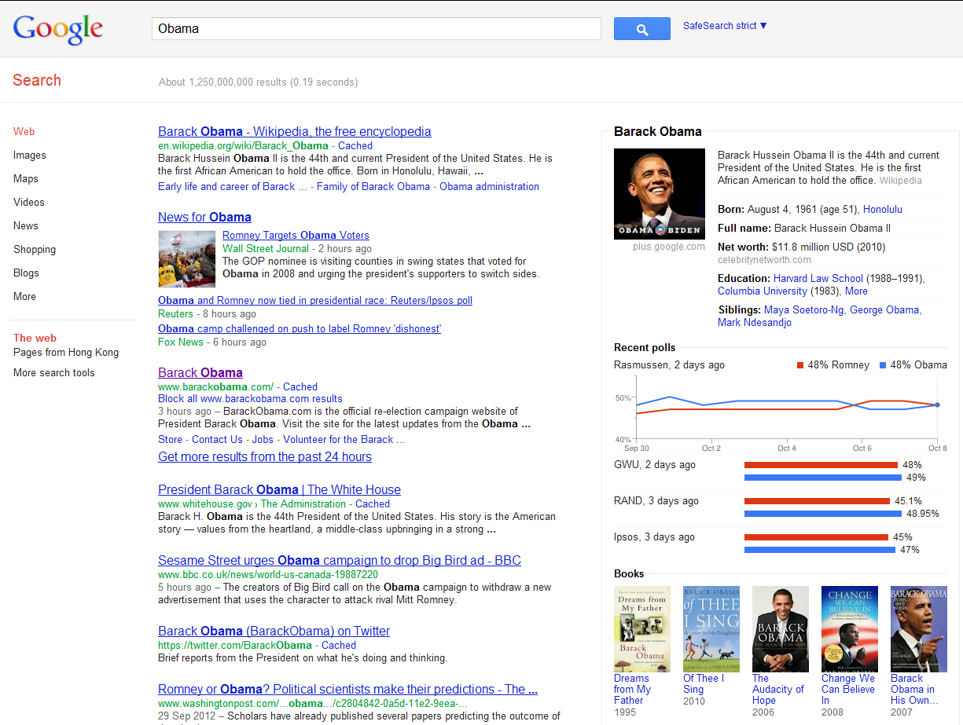
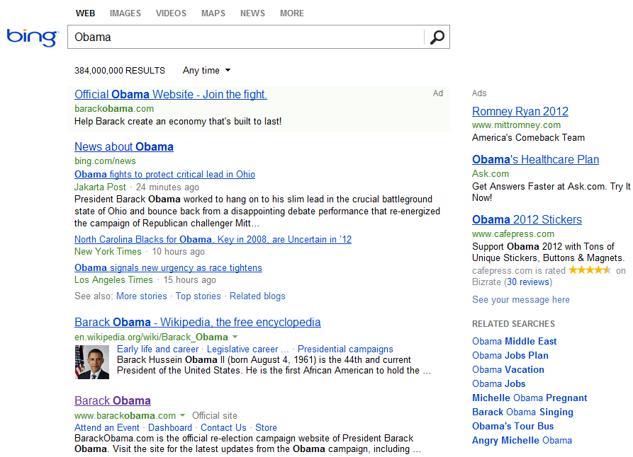
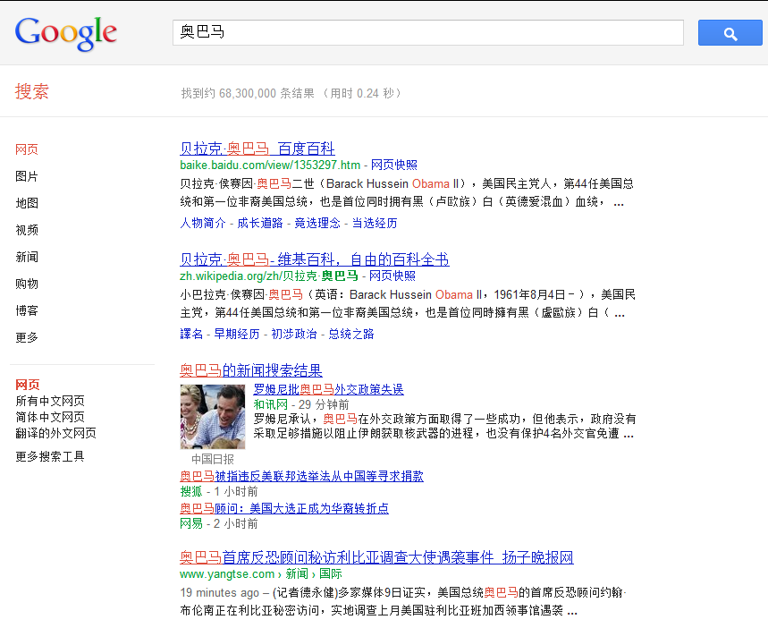
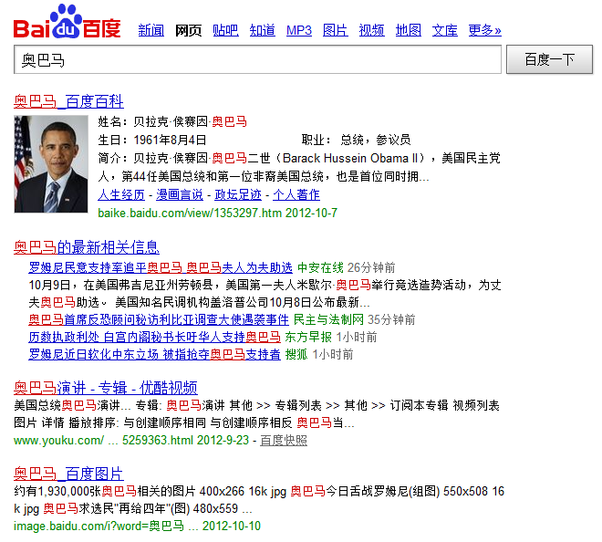
Fortunately, social network is coming…
Knowledge
Ads
Related Search

Slide 18
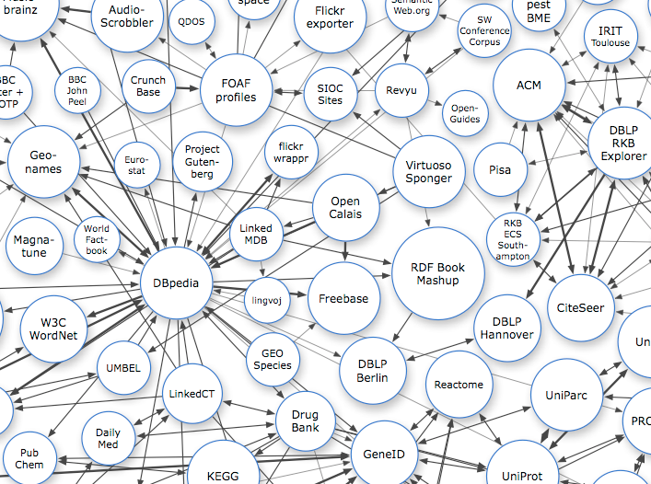

Knowledge Base
Wikipedia->DBpedia
The central position of multi-lingual DBpedia
DBpedia contains about 3.64 million English entities, 360 thousand Chinese entities

Slide 19

链接数据-万维网上的数据库

Slide 20
Now we have/need
Big data
Semantic (Knowledge graph)
Data mining/Machine learning
Search
…

Slide 21
AMiner.org —Deep Analysis and Mining for Academic Social Networks

Slide 22
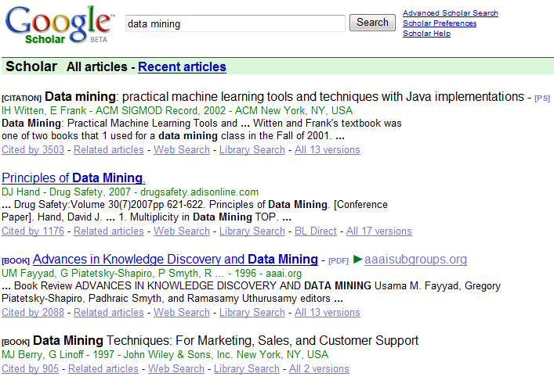
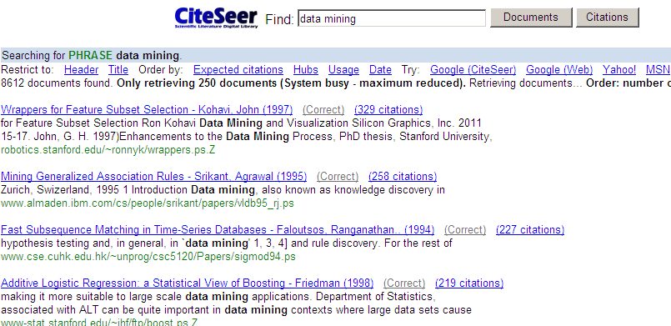

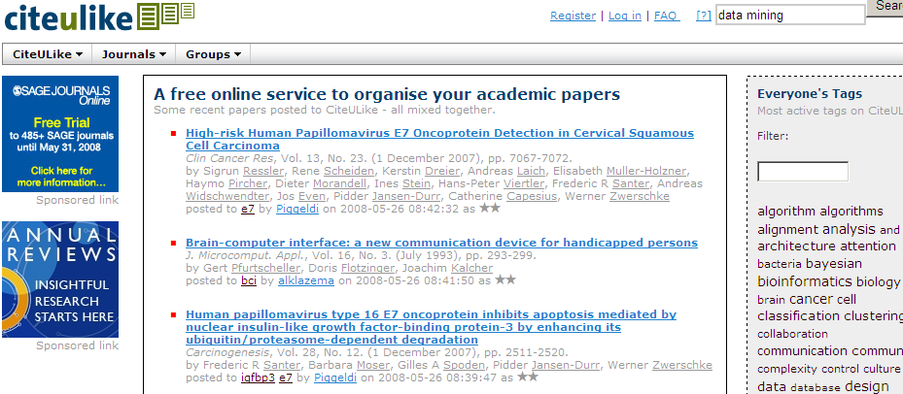
Why AMiner.org (Arnetminer)?
“The information need is not only about publication…”
“Academic search is treated as document search, but ignore semantics”
However, we are not satisfactory with …

Slide 23
Examples – Expertise search
When starting a
work in a new research topic;
Or brainstorming for novel ideas.
Who are experts in this field?
What are the top conferences in the field?
What are the best papers?
What are the top research labs?
Researcher A
?

Slide 24
Examples – Citation network analysis
Researcher B
an in-depth understanding of the research field?
?

Slide 25
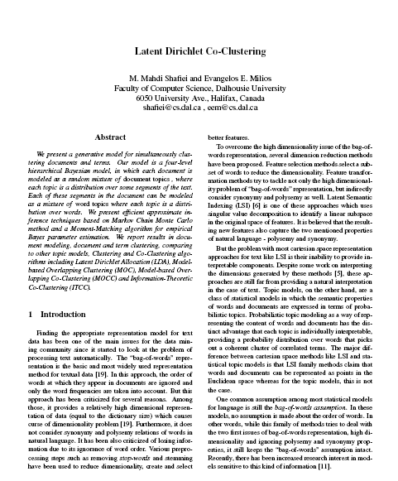

Examples – Conference Suggestion
authors
Which conference should we submit the paper?
?
Researcher C
content

Slide 26


Examples – Reviewer Suggestion
Who are best matching reviewers for each paper?
Who will accept the invitation to review the paper
KDD Committee
Conference/Journal
?
Paper content

Slide 27
Outline
ArnetMiner: Academic Social Network
Core Techniques
Knowledge Acquisition
Modeling and Heterogeneous Ranking
Social Network Analysis

Slide 28
AMiner.org - Academic research social network analysis and mining system
提供全面的研究者网络分析与挖掘功能
Papers published: ACM TKDD, IEEE TKDE, J. Informetrics, KDD’08-12, WWW’12, SIGMOD’09, IJCAI’09
http://aminer.org/

Slide 29
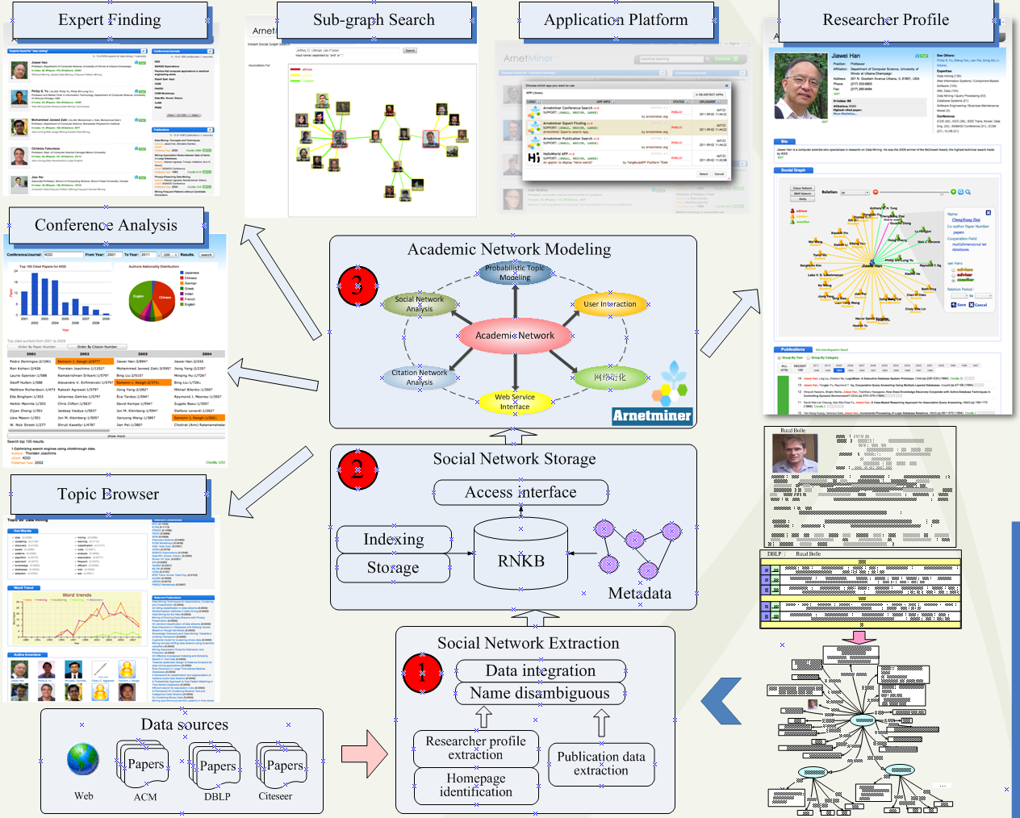
4
- Researcher profile extraction
- Expert finding
- Social network search
- Topic browser
- Conference analysis
- ArnetApp platform

Slide 30
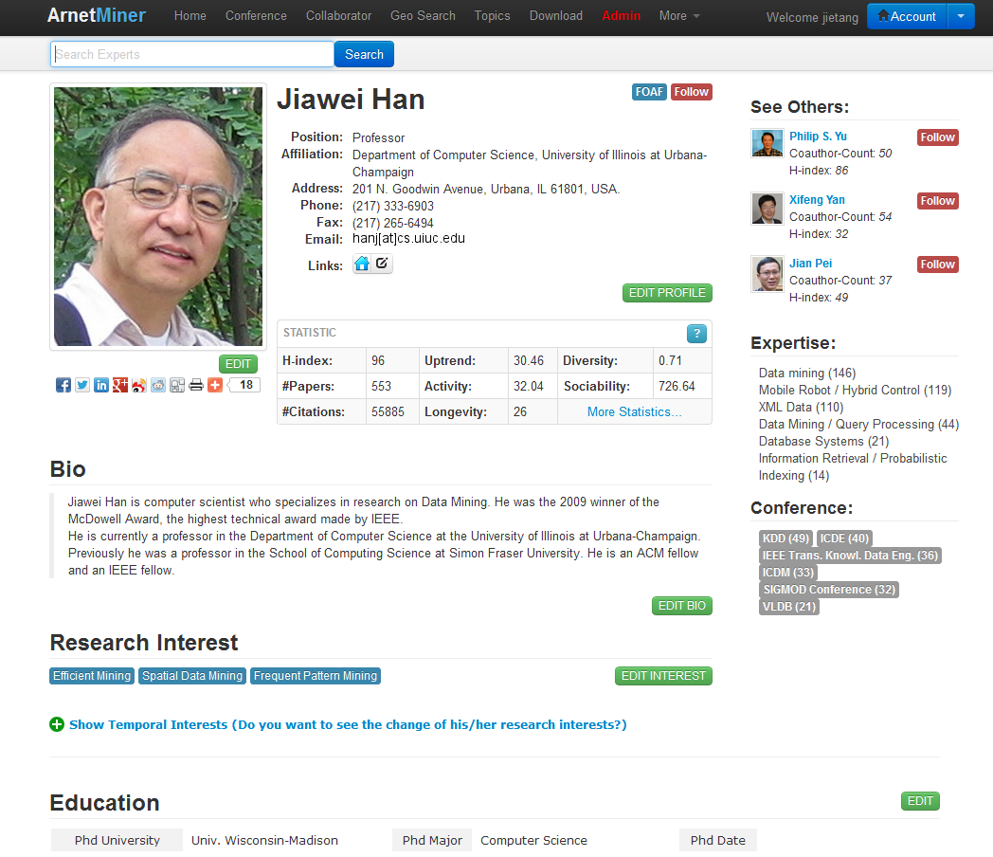
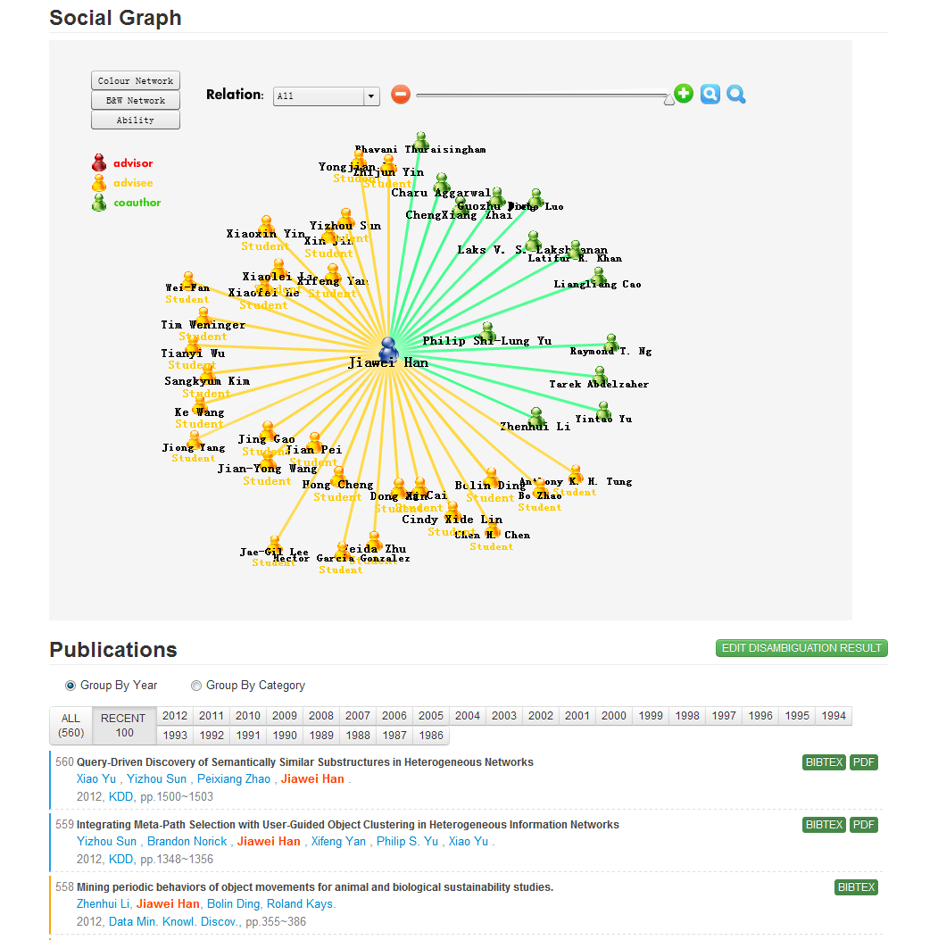
Person Search
Basic Info.
Citation statistics
Social Network
Research Interests
Publications

Slide 31
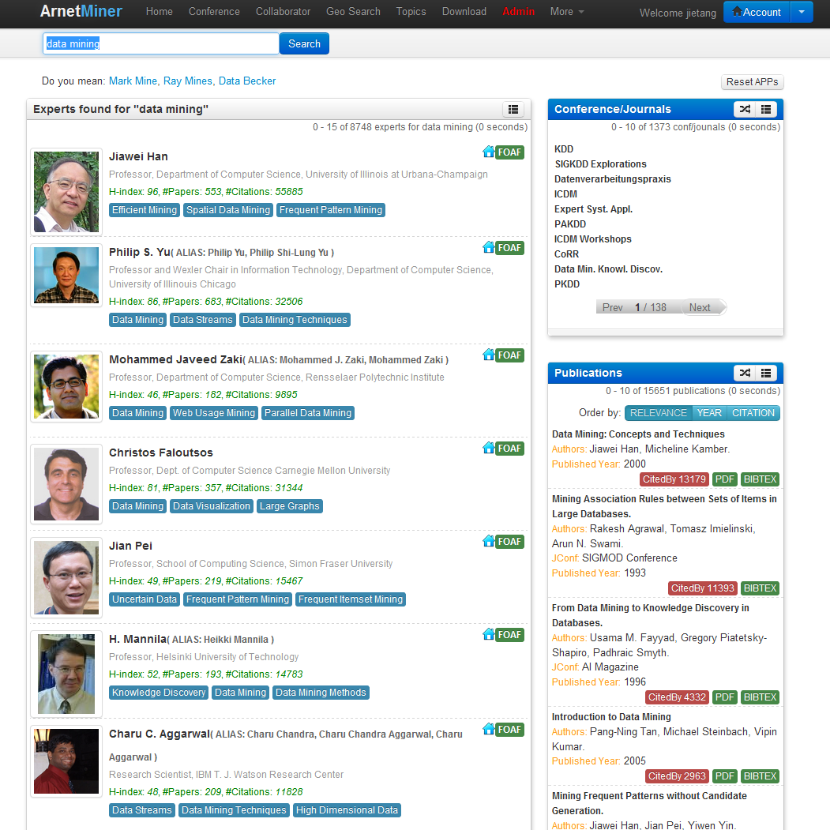
Expertise Search
Finding experts,
expertise conferences,
and expertise papers
for “data mining”

Slide 32
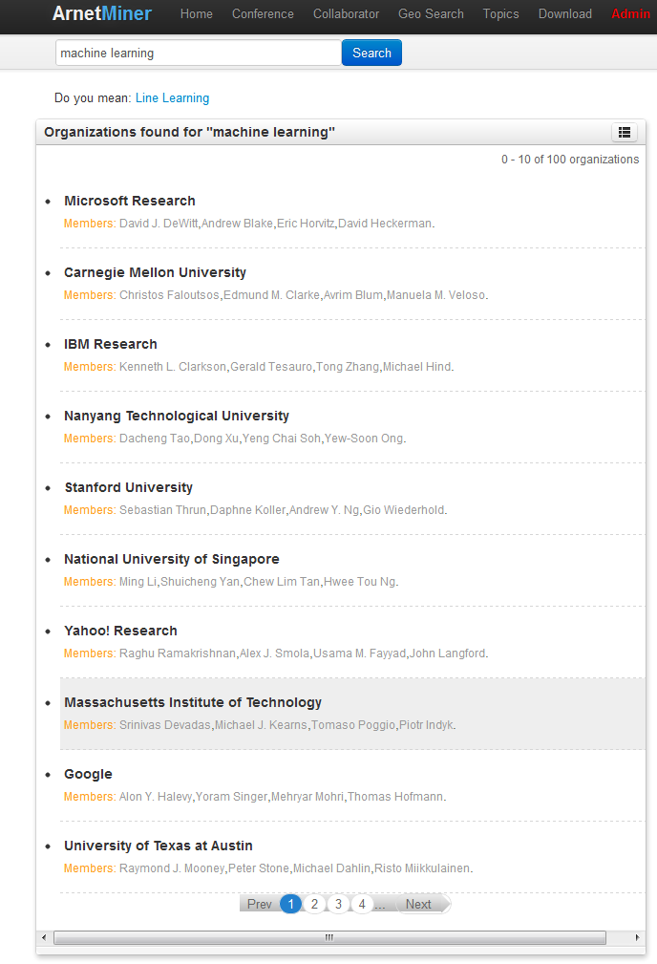
Organization Search
Ranking organizations
on “machine learning”

Slide 33
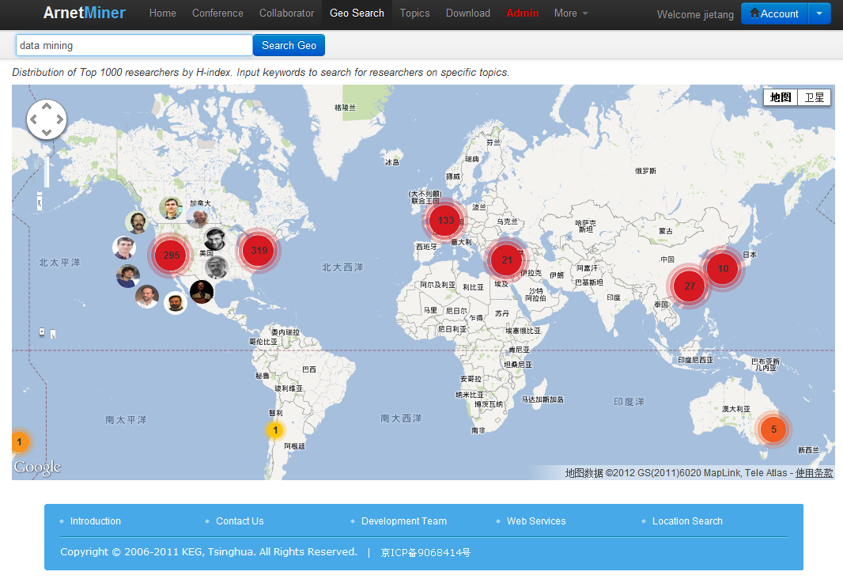
Geographic search
Finding the most hot regions on “data mining”

Slide 34
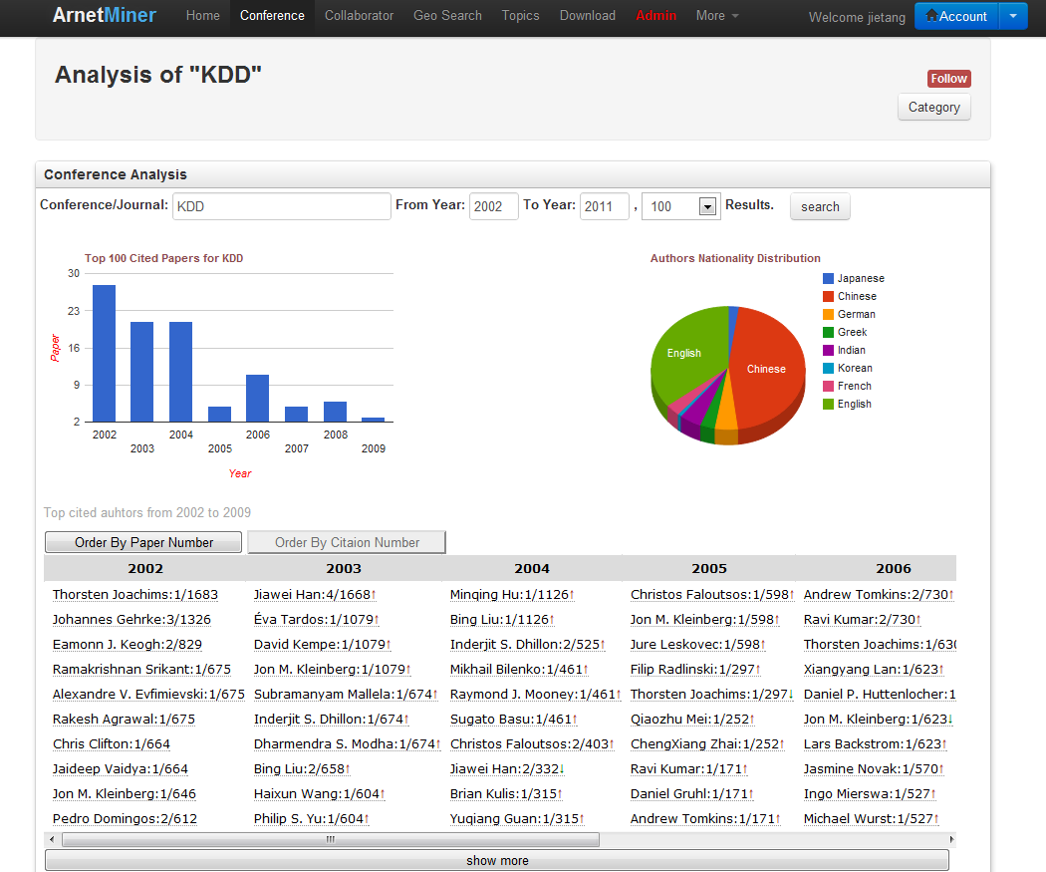
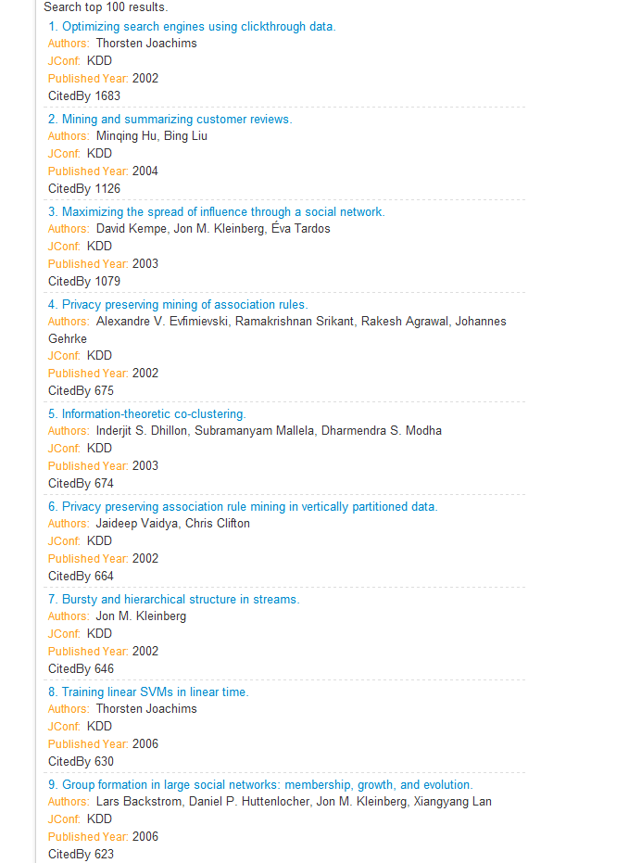
Conference Analysis
Which year is the most successful in the KDD’s history?
Who are the most cited authors?
What is author distribution for the highly cited KDD papers in the past years?

Slide 35
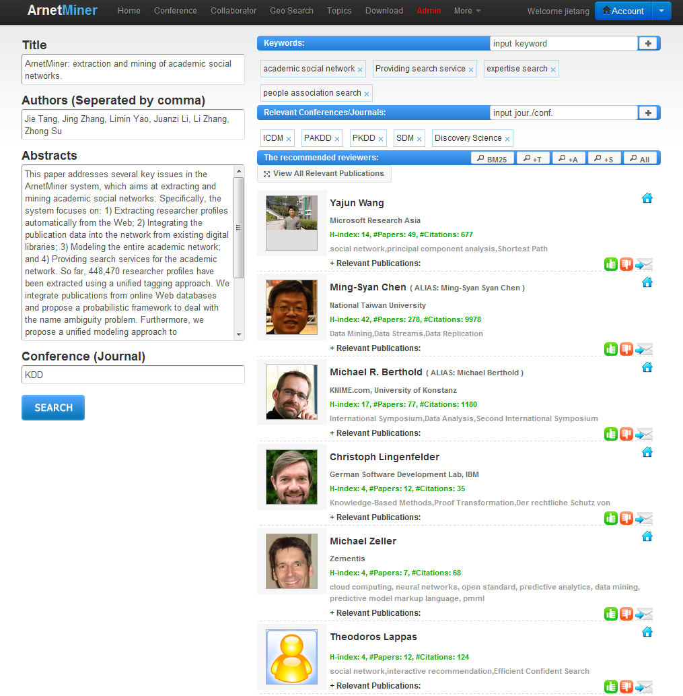
Reviewer Suggestion
Inerest matching
COI avoiding
Load balancing
Forcast review quality

Slide 36
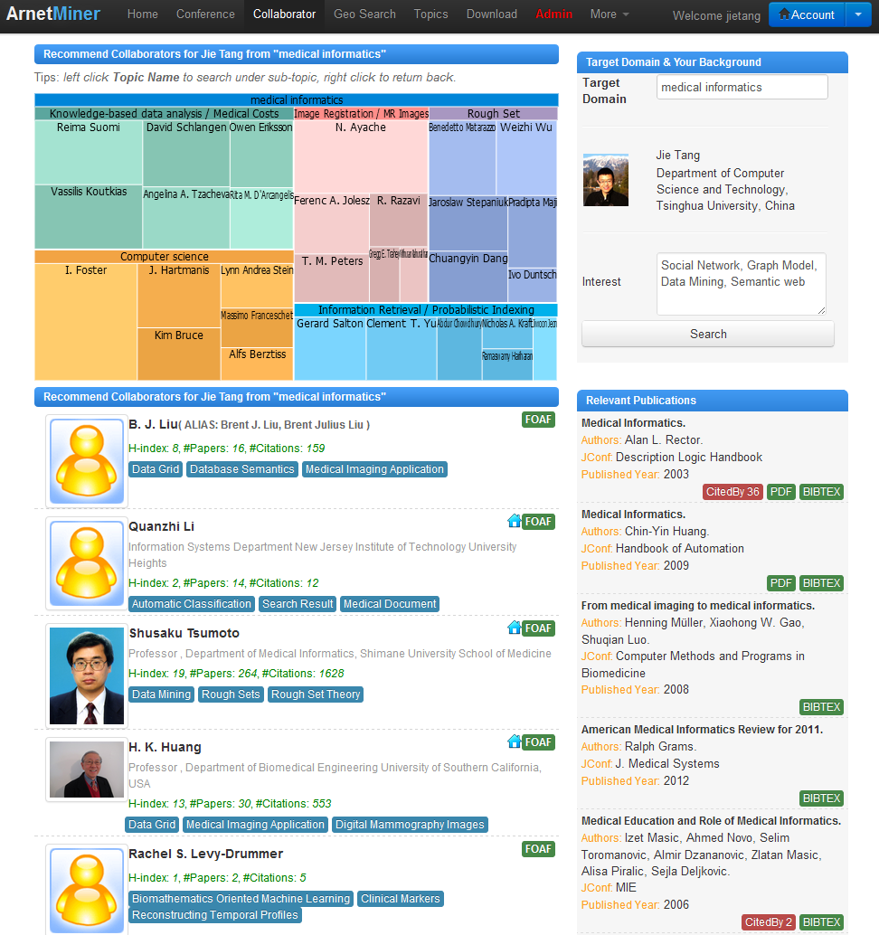
Cross-domain Collaboratinon Recommendation
What kinds of topics should you collaborate with the target domain?
Who are the best collaborators on each topic?

Slide 37
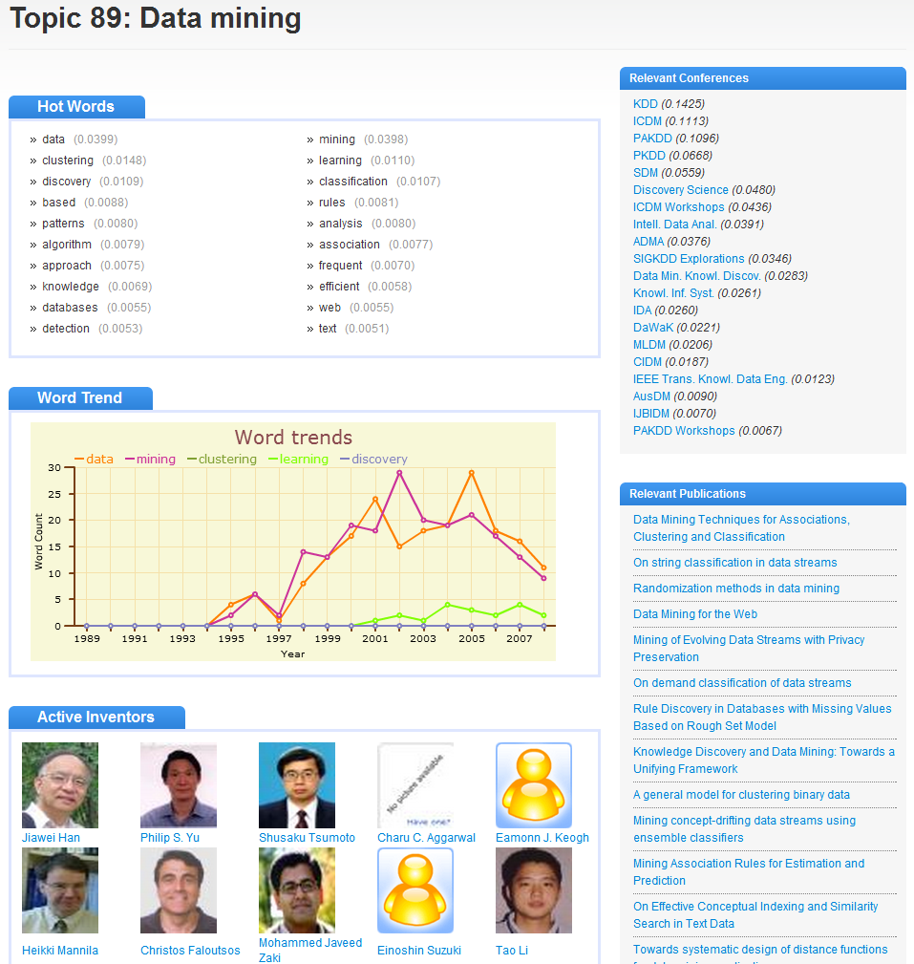
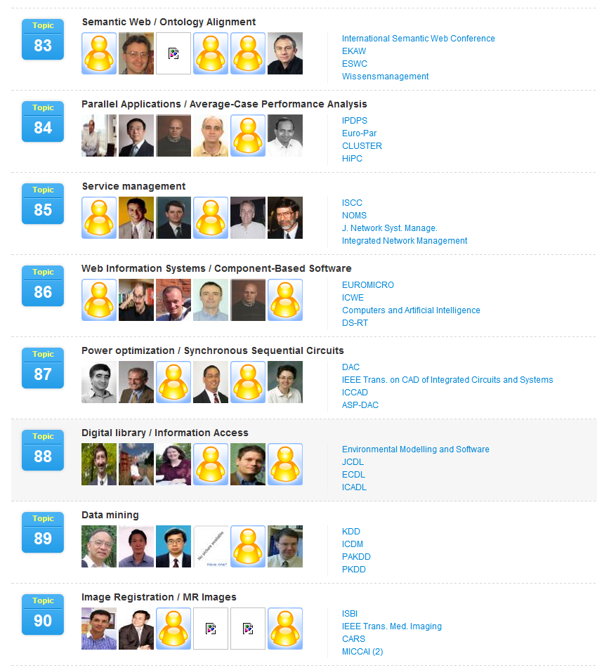
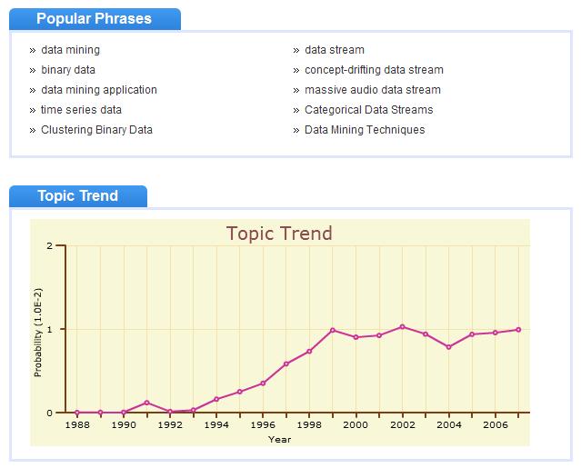
Topic Browser
200 topics have been discovered automatically from the academic network

Slide 38
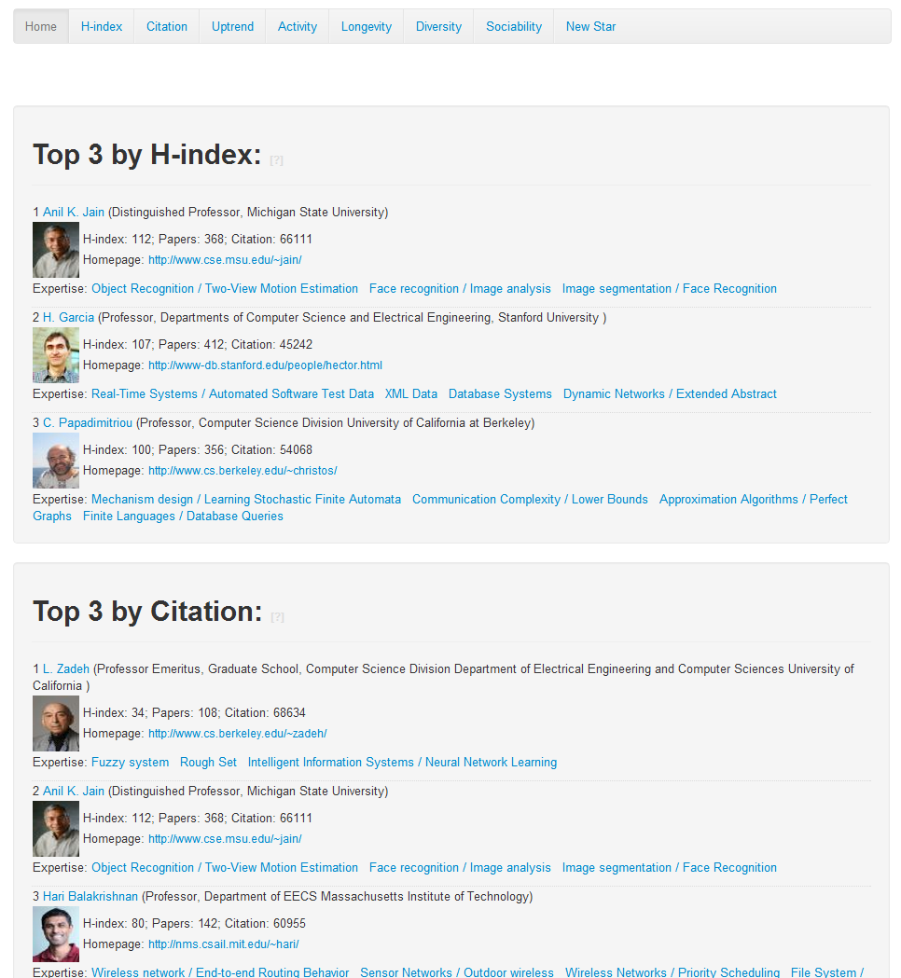
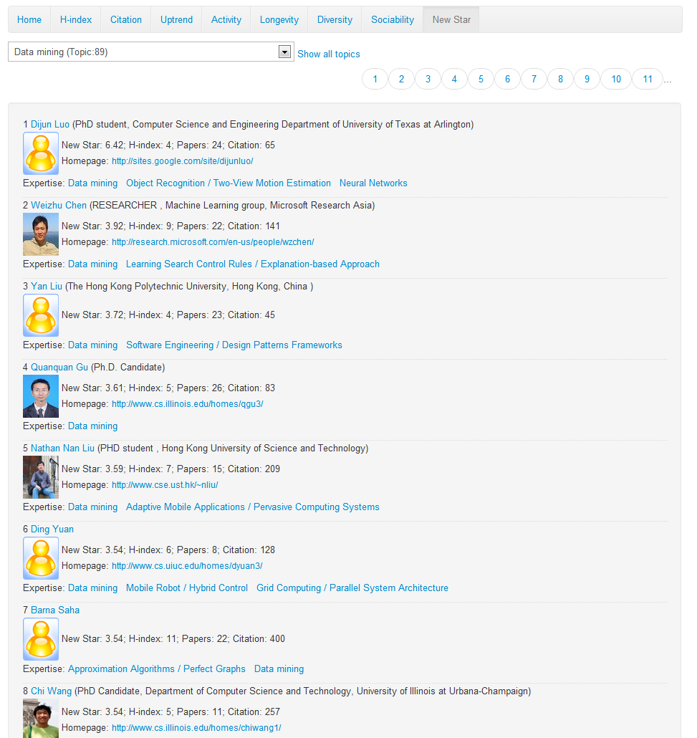
Academic Performance Measure
Academic Statistics
New Stars

Slide 39
AMiner (ArnetMiner)
Academic Social Network Analysis and Mining system—Aminer (http://arnetminer.org)
Online since 2006
>1 million researcher profiles
>131 million requests
>2.35 Terabyte data
100K IP access from 170 countries per month
10% increase of visits per month
Deep SN analysis, mining, and search

Slide 40
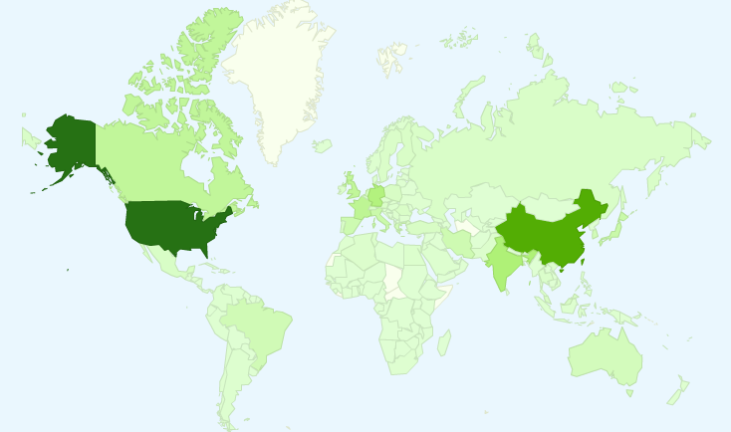
User Distribution
4.04 million IP from 220 countries/regions

Slide 41
User Distribution
4.04 million IP from 220 countries/regions
Top 10 countries
1. USA 6. Canada
2. China 7. Japan
3. Germany 8. Spain
4. India 9. France
5. UK 10. Italy

Slide 42
Outline
ArnetMiner: Academic Social Network
Core Techniques
Knowledge Acquisition
Modeling and Heterogeneous Ranking
Social Network Analysis

Slide 43
CT1: Knowledge Acquisition from Social Web (ACM TKDD, WWW’12, ISWC’06, ICDM’07, ACL’07)
2
Contact Information
1
Two questions:
How to accurately extract the researcher profile information from the Web?
How to integrate the information from different sources?
Educational history
1
Academic services
Publications
1
2
1
coauthor
Ruud Bolle
affiliation
UIUC
Publication #3
2
2
position
Professor
Publication #5
coauthor

Slide 44
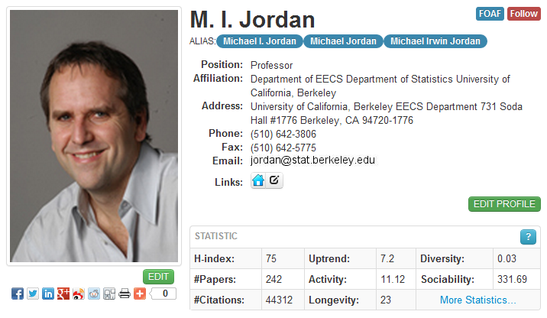
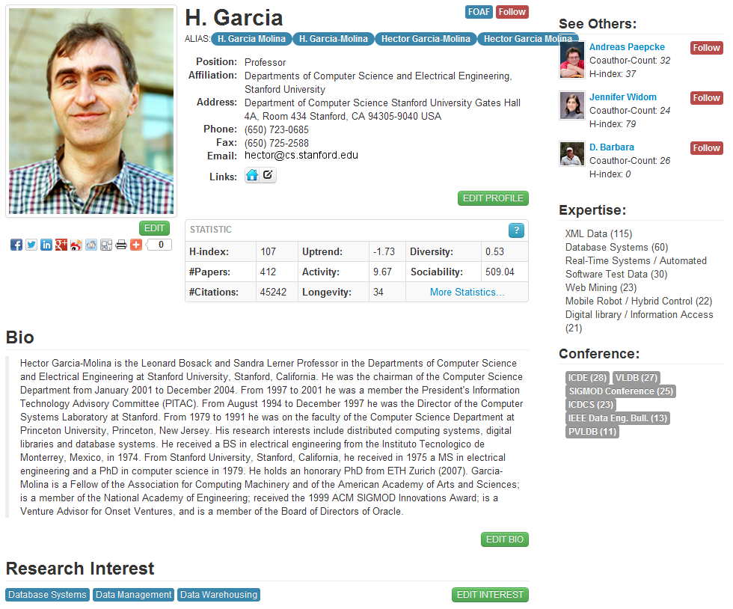
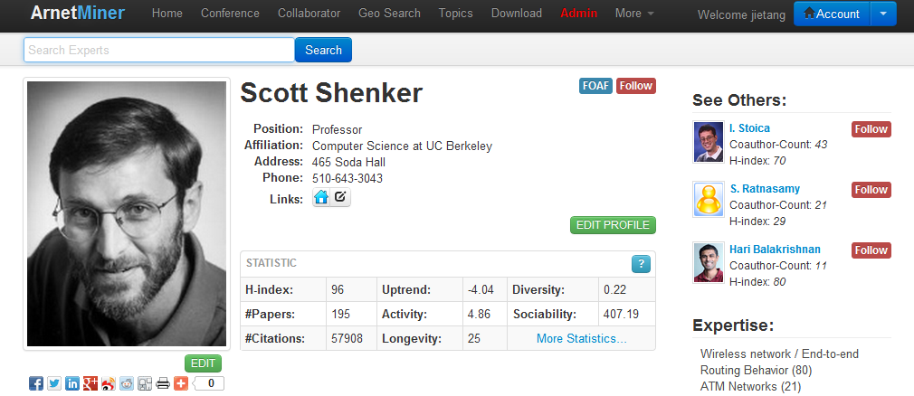
Researcher Profile Database^{[1]}
Extracted more than 1,000,000 researcher profiles from the Web
[1] J. Tang, L. Yao, D. Zhang, and J. Zhang. A Combination Approach to Web User Profiling. ACM Transactions on Knowledge Discovery from Data (TKDD), (vol. 5 no. 1), Article 2 (December 2010), 44 pages.

Slide 45
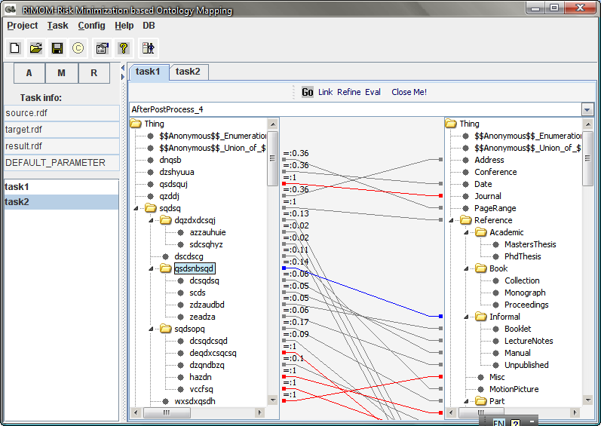
RiMOM^{[1-3]}-A Tool for Semantic Integration (OAEI’06-09)
Chair Message:
“I’m really surprised by the good results of these years RiMOM, you can compete with the top systems that make use of such background knowledge.”
http://keg.cs.tsinghua.edu.cn/project/RiMOM/
[1] J. Li, J. Tang, Y. Li, and Q. Luo. RiMOM: A Dynamic Multi-Strategy Ontology Alignment Framework. IEEE Transaction on Knowledge and Data Engineering (TKDE). August 2009 (vol. 21 no. 8) pp. 1218-1232.
[2] Q. Zhong, H. Li, J. Li, G. Xie, J. Tang, and L. Zhou. A Gauss Function based Approach for Unbalanced Ontology Matching. SIGMOD’09, pages 669-680, 2009.
[3] Z. Wang, J. Li, Z. Wang, and J. Tang. Cross-lingual Knowledge Linking Across Wiki Knowledge Bases. WWW’12, pages 459-468, 2012.
Notes:
45

Slide 46
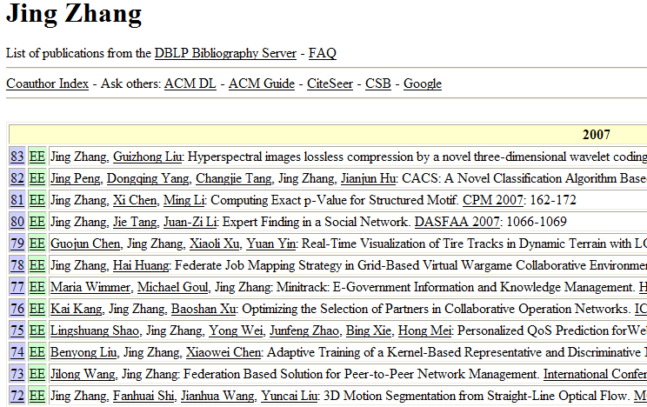
Name Disambiguation^{[1,2]}
Name | Affiliation
Jing Zhang (26) | Shanghai Jiao Tong Univ.
 | Yunnan Univ.
 | Tsinghua Univ.
 | Alabama Univ.
 | Univ. of California, Davis
 | Carnegie Mellon University
 | Henan Institute of Education
- How to perform the assignment automatically?
- How to estimate the person number?
[1] J. Tang, A.C.M. Fong, B. Wang, and J. Zhang. A Unified Probabilistic Framework for Name Disambiguation in Digital Library. IEEE Transaction on Knowledge and Data Engineering (TKDE) , Volume 24, Issue 6, 2012, Pages 975-987.
[2] X. Wang, J. Tang, H. Cheng, and P. S. Yu. ADANA: Active Name Disambiguation. ICDM’11, pages 794-803, 2011.

Slide 47
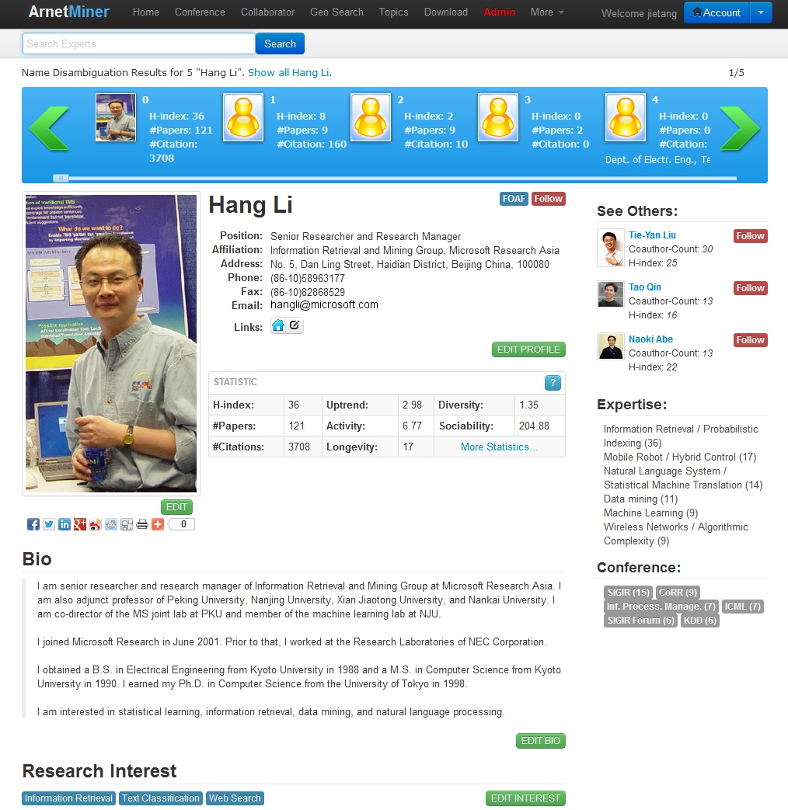
Disambiguation Performance

Slide 48
Outline
ArnetMiner: Academic Social Network
Core Techniques
Knowledge Acquisition
Modeling and Heterogeneous Ranking
Social Network Analysis

Slide 49
CT2: Topic-based Heterogeneous Ranking (KDD’08, KDD’12, Machine Learning)
Data mining
Modeling using VSM
Principles of Data Mining.
DJ Hand - Drug Safety, 2007 - drugsafety.adisonline.com
Search with keyword
Return
Advances in Knowledge Discovery and Data Mining
UM Fayyad, G Piatetsky-Shapiro, P Smyth, R…
Data Mining: Concepts and Techniques
J Han, M Kamber - 2001…
Search with semantic modeling
Modeling using semantic topics
Experts
Expertise conferences
Topics
Data mining
0.4
Association Rules
Return
Data mining
0.2
Database systems
0.15
0.1
Data management
0.05
0.02
Web databases
Information systems
Expertise papers

Slide 50
(1) Modeling the Academic Network^{[1]}
authors
words
Topic
ACT1
conference
ACT2
ACT3
Author-Conference-Topic Model
[1] J. Tang, J. Zhang, L. Yao, J. Li, L. Zhang, and Z. Su. ArnetMiner: Extraction and Mining of Academic Social Networks. SIGKDD’08. pages 990-998, 2008.

Slide 51
Generative Story of ACT1 Model
Paper
Latent Dirichlet Co-clustering
Shafiei and Milios
We present a generative model for clustering documents and terms. Our model is a four hierarchical bayesian model. We present efficient inference techniques based on Markow Chain Monte Carlo. We report results in document modeling, document and terms clustering …
NLP
P(c|z)
ICDM 0.23
KDD 0.19
….
IR
ICDM
NIPS
mining 0.23
clustering 0.19
classification 0.17
….
ML
P(w|z)
DM
clustering
Shafiei
NLP
inference
IR
P(c|z)
ICML 0.23
NIPS 0.19
….
DM
ML
model 0.23
learning 0.19
boost 0.17
….
P(w|z)
Milios
Generative process
Notes:
51

Slide 52
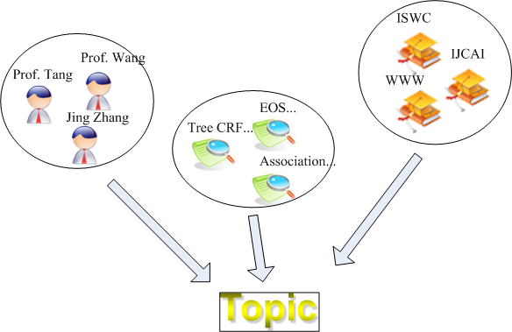
(2) Integrating with Random Walk^{[1]}
Modeling academic network with topics
Random walk over the academic network
+
Author-Conference-Topic Model [Tang et al., 08]
[1] J. Tang, J. Zhang, R. Jin, Z. Yang, K. Cai, L. Zhang, and Z. Su. Topic Level Expertise Search over Heterogeneous Networks. Machine Learning Journal, Volume 82, Issue 2 (2011), Pages 211-237.

Slide 53
Outline
ArnetMiner: Academic Social Network
Core Techniques
Knowledge Acquisition
Modeling and Heterogeneous Ranking
Social Network Analysis

Slide 54
CT3: Social Network Analysis (KDD’09, ’10, ’11, DMKD’12, JIS)
User modeling: can we model and forcast users’ behaviors?
Influence: how to quantify the influence between users?
Tie: what is the relationship between users?
Community: which (core) communities determine the evolution of the network structrure?

Slide 55
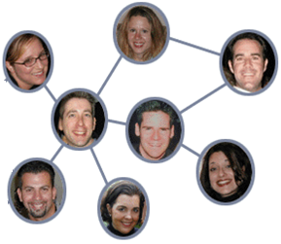
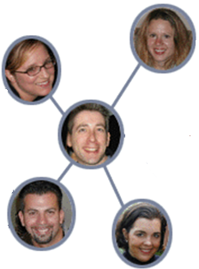
(1) Social Action Modeling and Prediction^{[1]}
Action Prediction：
Will John submit a paper to KDD’12?
Influence
1
Time t+1
Time t
John
John
Correlation
3
Action bias
4
Personal attributes:
Interested in data mining
Collaborated with Jiawei Han
….
Dependence
2
[1] C. Tan, J. Tang, J. Sun, Q. Lin, and F. Wang. Social Action Tracking via Noise Tolerant Time-varying Factor Graphs. SIGKDD’10, pages 1049-1058, 2010.

Slide 56
(2) Social Influence Analysis ^{[1]}
Several key challenges:
How to differentiate the social influences from different topics?
How to incorporate both structure and content into a unified model?
How to estimate the model on real-large networks?
[1] J. Tang, J. Sun, C.Wang, and Z. Yang. Social influence analysis in largescale networks. In Proceedings of the 15th ACM SIGKDD International Conference on Knowledge Discovery and Data Mining (SIGKDD’09), pages 807–816, 2009.

Slide 57
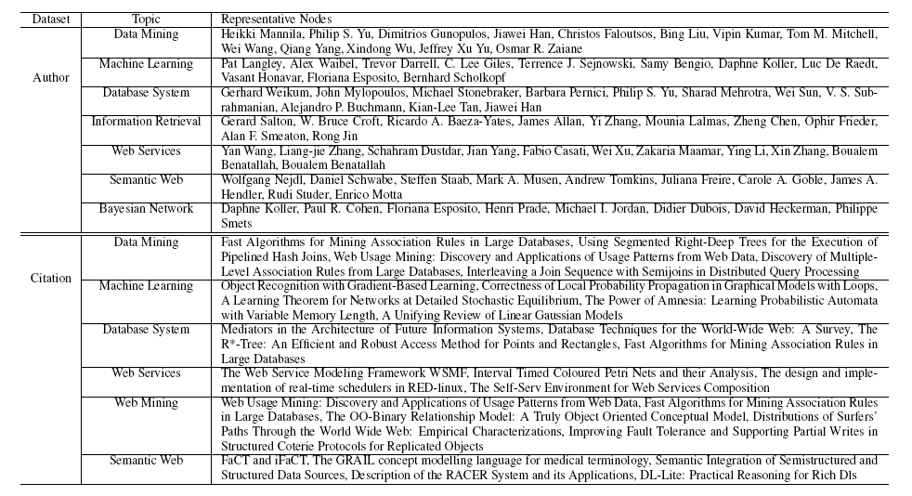
Influential nodes on different topics

Slide 58
(3) Mining Advisor-Advisee Relationship^{[1]}
Dynamic collaborative network
Labeled network
Output: potential types of relationships and their probabilities:
(type, prob, [s_time, e_time])
[1] C. Wang, J. Han, Y. Jia, J. Tang, D. Zhang, Y. Yu, and J. Guo. Mining Advisor-Advisee Relationships from Research Publication Networks. SIGKDD'10. pages 203-212, 2010.

Slide 59
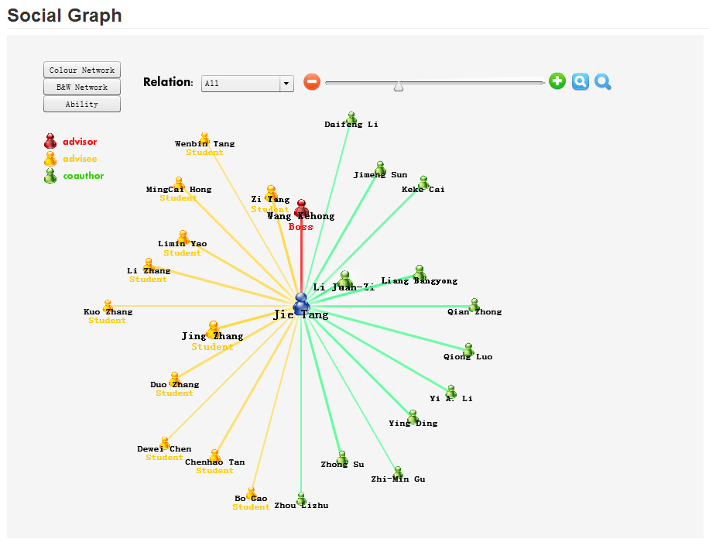
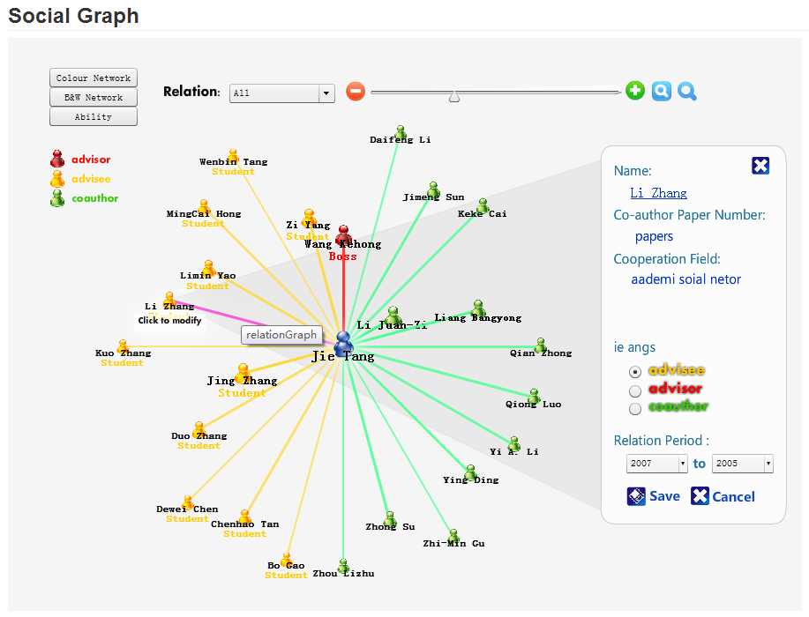
Results

Slide 60
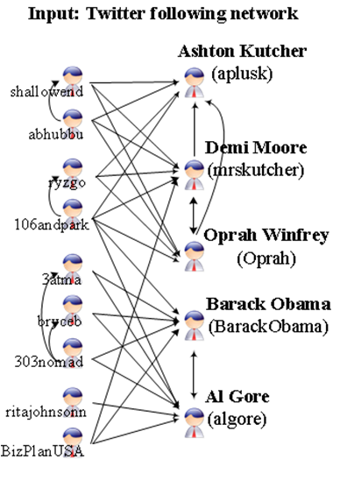
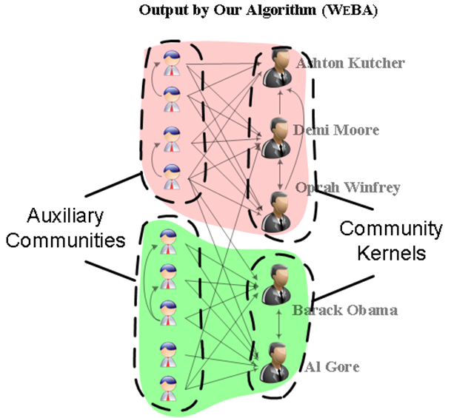
(4) Community Kernel[1]
Pareto Principle: Less than 1% of the Twitter users (e.g. entertainers, politicians, writers) produce 50% of its content, while the others (e.g. fans, followers, readers) have much less influence and completely different social behavior.
Kernel users and ordinary users exhibit very different behaviors.
[1] L. Wang, T. Lou, J. Tang, and J. Hopcroft. Detecting Community Kernels in Large Social Networks. ICDM’11, pages 784-793, 2011.
Notes:
60

Slide 61
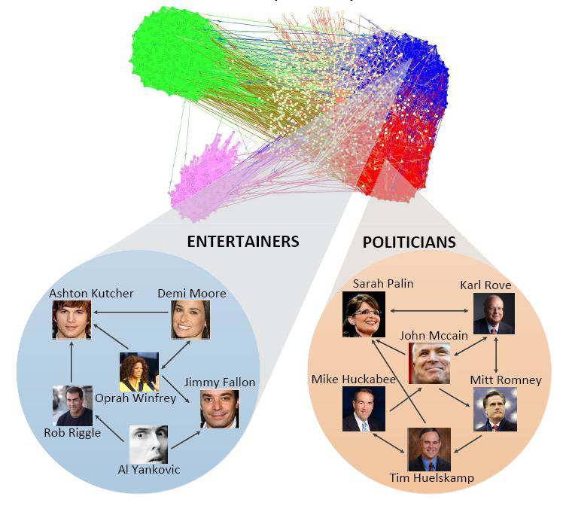

Slide 62


Efficiency — Twitter & Coauthor
465,023 nodes, 833,590 edges
822,415 nodes, 2,928,360 edges

Slide 63
Arnetminer Today — A brief summary

Slide 64
ArnetMiner’s History
Date | Version | New Features
2006/5 | V0.1 | Profile extraction, person/paper/conf. search
2006/8 | V1.0 | Rewritten all codes in Java.
2007/7 | V2.0 | Survey search, research interest, association search
2008/4 | V3.0 | Query understanding, New search GUI, log analysis
2008/11 | V4.0 | Graph search, topic mining, NSFC/NSF
2009/4 | V5.0 | Bole/course search, profile editing, open resources, #citation
2009/12 | V6.0 | Academic statistics, user feedbacks, refined ranking
2010/5 | V7.0 | Name disambiguation, reviewer assignment, supervisor suggestion, open API
2010/7 | V8.0 | ArnetApp Platform
2011/7 | V II | AMiner, location search, conference analysis
2012 | V 1.0 | New UI, cross-domain collaboration

Slide 65




Aminer History
2006
2009
2010
2012
描述信息抽取
学术数据集成
研究兴趣分析
2006年5月系统正式上线运行
话题分析
课程搜索
学术社区
187个国家/地区52万独立IP
关系分析
命名排歧
审稿人推荐
202个国家/地区102万独立IP
应用开发平台
地理搜索
协作关系推荐
220个国家/地区432万独立IP

Slide 66





Widely used..
The largest publisher:
Elsevier
Conferences
KDD 2010
KDD 2011
KDD 2012
WSDM 2011
ICDM 2011
ICDM 2012
SocInfo 2011
ICMLA 2011
WAIM 2011
etc.
……

Slide 67





ArnetApp Platform ---to deploy your apps on Arnetminer.org To customize the search on Arnetminer.

Slide 68
Arnetminer as a platform…
Arnetminer
Mining Pubmed data
Expert finding
Ranking subgraphs
Novel search
Instant search
PubmedMiner
Mining more data…
Mining “QQ”
Association search
Influence analysis
Hot topic detection
...
Mining knowledge from patents:
competitor analysis
company search
patent summarization
QQMiner
PatentMiner

Slide 69
PatentMiner

Slide 70

Patent Search
Related sub topics
Patents on “data mining”
Inventor
Company

Slide 71

Competitor Analysis

Slide 72






Slide 73



PatentMiner Today
* Patent data:
> 3.8M patents
> 2.4M inventors
> 400K companies
> 10M citation relationships
* Journal data:
> 2k journal papers
> 3.7k authors
The crawled data is increasing to >300 Gigabytes.

Slide 74




Opportunity: exploiting social network and semantic web in the real-world
Web, relational data, ontological data, social data
Data Mining and Social Network techniques
Scientific
Literature
Users cover >180
countries
>600K researcher
>3M papers
Arnetminer.org
(NSFC, 863)
Social search
& mining
Social extraction
Social mining
IBM US, Tencent
IBM CRL
Advertisement
Advertisement
Recommendation
Sohu
Mobile Context
Mobile search
& recommendation
Nokia
Energy trend
analysis
Energy product
Evolution
Techniques
Trend
Oil Company
Large-scale
Mining
Scalable algorithms
for message tagging
and community
Discovery
Google
国家核高基项目 (NSFC)
自然科学基金重点 (NSFC Key)
科技信息资源内容监测与分析服务平台 (中国科技部信息情报研究所)
Search, browsing, complex query, integration, collaboration, trustable analysis, decision support, intelligent services,

Slide 75
Representative Publications
Jie Tang, Jing Zhang, Ruoming Jin, Zi Yang, Keke Cai, Li Zhang, and Zhong Su. Topic Level Expertise Search over Heterogeneous Networks. Machine Learning Journal, 2011.
Jie Tang, Limin Yao, Duo Zhang, and Jing Zhang. A Combination Approach to Web User Profiling. ACM TKDD, 2010.
Jie Tang, A.C.M. Fong, Bo Wang, and Jing Zhang. A Unified Probabilistic Framework for Name Disambiguation in Digital Library. IEEE TKDE, 2012.
Juanzi Li, Jie Tang, Yi Li, Qiong Luo. RiMOM: A Dynamic Multi-Strategy Ontology Alignment Framework. IEEE TKDE, 2009. (Top 6 cited papers among TKDE 2009's papers)
Jie Tang, Juanzi Li, Bangyong Liang, Xiaotong Huang, Yi Li, and Kehong Wang. Using Bayesian Decision for Ontology Mapping. JoWS, 2006. (if =3.41) (Top 10 cited papers in JWS's history)
Zi Yang, Keke Cai, Jie Tang, Li Zhang, Zhong Su, and Juanzi Li. Social Context Summarization. SIGIR’11.
Jie Tang, Sen Wu, Jimeng Sun, and Hang Su. Cross-domain Collaboration Recommendation. KDD'12 (Full Presentation & Best Poster Award)
Jie Tang, Bo Wang, Yang Yang, Po Hu, Yanting Zhao, Xinyu Yan, Bo Gao, Minlie Huang, Peng Xu, Weichang Li, and Adam K. Usadi. PatentMiner: Topic-driven Patent Analysis and Mining. KDD'12.
Chenhao Tan, Lillian Lee, Jie Tang, Long Jiang, Ming Zhou, and Ping Li. User-level sentiment analysis incorporating social networks. KDD'11.
Chenhao Tan, Jie Tang, Jimeng Sun, Quan Lin, and Fengjiao Wang. Social Action Tracking via Noise Tolerant Time-varying Factor Graphs. KDD’10.
Chi Wang, Jiawei Han, Yuntao Jia, Jie Tang, Duo Zhang, Yintao Yu, Jingyi Guo. Mining Advisor-Advisee Relationships from Research Publication Networks. KDD’10.
Jie Tang, Jimeng Sun, Chi Wang, and Zi Yang. Social Influence Analysis in Large-scale Networks. KDD'09.
(Top 4 cited papers among KDD 2009's papers)
Jie Tang, Jing Zhang, Limin Yao, Juanzi Li, Li Zhang, and Zhong Su. ArnetMiner: Extraction and Mining of Academic Social Networks. KDD’08. (Top 6 cited papers among KDD 2008's papers)
Jie Tang, Ho-fung Leung, Qiong Luo, Dewei Chen, and Jibin Gong. Towards Ontology Learning from Folksonomies. IJCAI’09.

Slide 76
Thanks!
Demo: http://arnetminer.org
HP: http://keg.cs.tsinghua.edu.cn/jietang/

Slide 77
The era of big and complex data…
Web trend
Data centric → User centric
Offline sparse social → Online dense social
Large-scale data mining → Big data deep analystic
Tech trend
Formal text → Informal text
User modeling → Collective intelligence
Keyword-based modeling → Semantic-based modeling
Macro-level analysis → Micro-level analysis
…

